Slide 1
UDP Client Server implementation in C
Dr. Asif Uddin Khan

Slide 2
Socket program using UDP
In UDP, the client does not form a connection with the server like in TCP and instead just sends a datagram.
Similarly, the server need not accept a connection and just waits for datagram to arrive.
Datagram upon arrival contain the address of sender which the server uses to send data to the correct client.

Slide 3
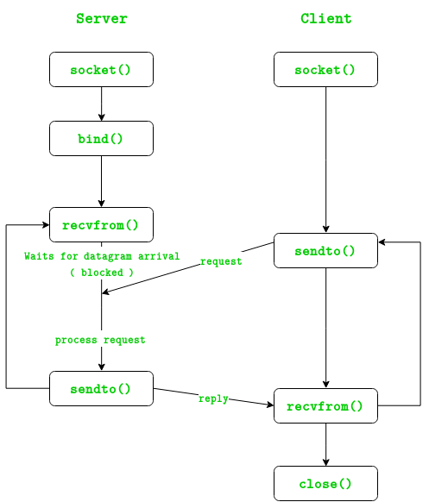

Slide 4
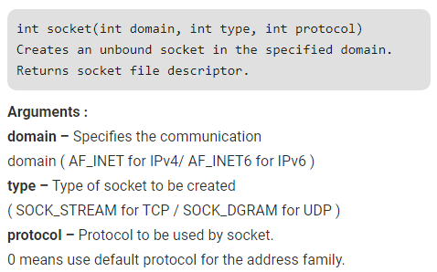
Necessary Functions
Example:
sockfd = socket(AF_INET, SOCK_DGRAM, 0)

Slide 5
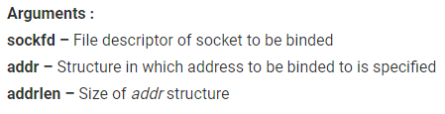
int bind(int sockfd, const struct sockaddr *addr, socklen_t addrlen) Assigns address to the unbound socket.
Example:
bind(sockfd, (const struct sockaddr *)&servaddr, sizeof(servaddr)

Slide 6
sendto() function
ssize_t sendto(int sockfd, const void *buf, size_t len, int flags, const struct sockaddr *dest_addr, socklen_t addrlen);
sockfd: The socket descriptor.
buf: A pointer to the data to be sent.
len: The length of the data to send.
flags: Flags to modify the behavior of the function (usually 0 for default behavior).
dest_addr: A pointer to the structure containing the destination address.
addrlen: The size of the destination address structure.

Slide 7
Recvfrom() function
ssize_t recvfrom(int sockfd, void *buf, size_t len, int flags, struct sockaddr *src_addr, socklen_t *addrlen);
sockfd: The socket descriptor from which the data is received.
buf: A pointer to the buffer where the incoming data will be stored.
len: The length of the buffer.
flags: Flags to modify the behavior of the function (usually 0 for default behavior).
src_addr: A pointer to a sockaddr structure to store the source address.
addrlen: A pointer to a socklen_t variable that stores the size of the address.

Slide 8
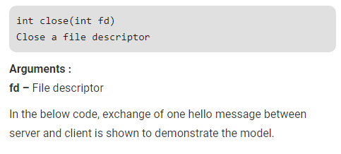

Slide 9
Steps
UDP Server :
Create UDP socket.
Bind the socket to server address.
Wait until datagram packet arrives from client.
Process the datagram packet and send a reply to client.
Go back to Step 3.

Slide 10
UDP Client
Create UDP socket.
Send message to server.
Wait until response from server is received.
Process reply and go back to step 2, if necessary.
Close socket descriptor and exit.

Slide 11
Assignment-8
Write UDP client server program for exchanging message between client and server.

